Slide 1
ALPhA Week 13: (4/12/19 – 4/19/19)
Gray Selby
AT-TPC Alpha – Alpha Classification

Slide 2
I replaced the pytpc peak charge values with my own values calculated from the max minus the min of each trace.
This resulted in clearer plots.
It seems even more apparent that the AT-TPC was tilted.

Slide 3
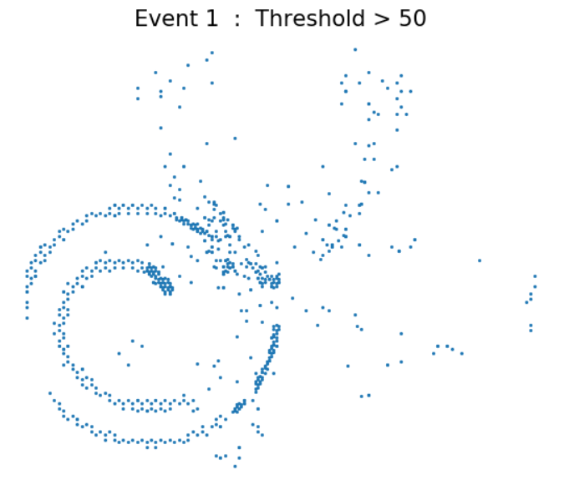
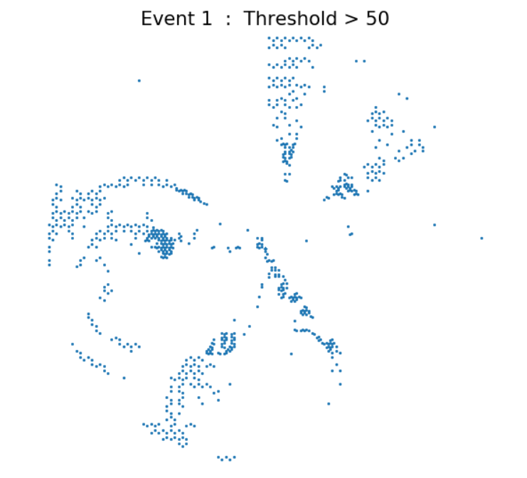
pytpc peak charge values
Manual peak charge values

Slide 4
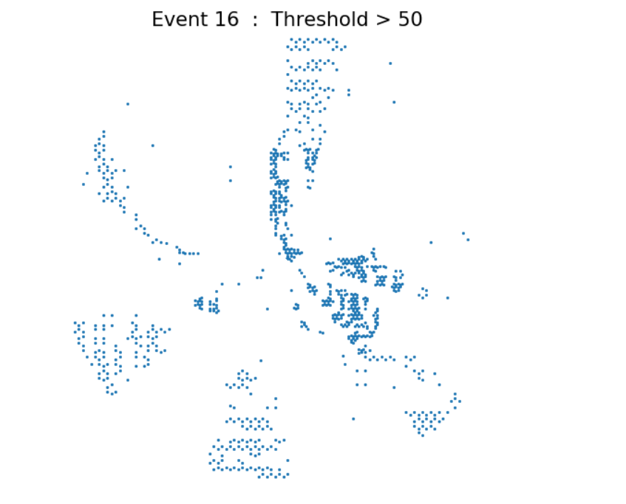
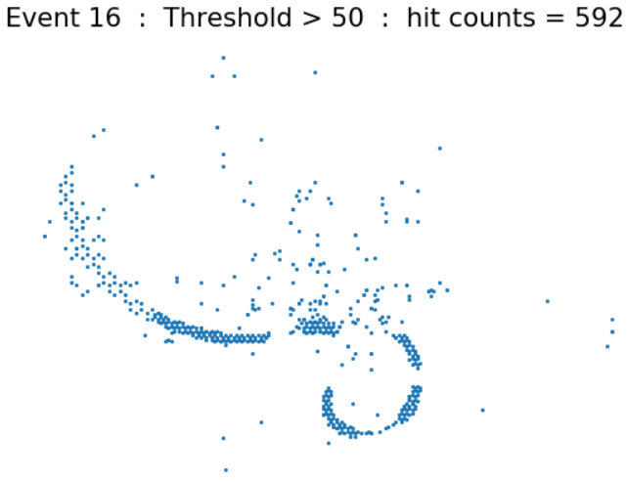
pytpc peak charge values
Manual peak charge values

Slide 5
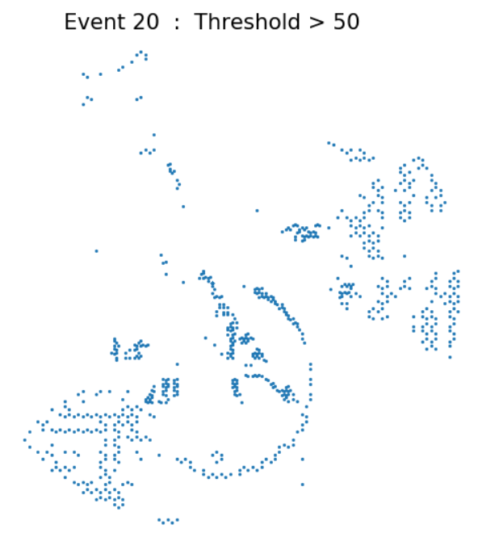
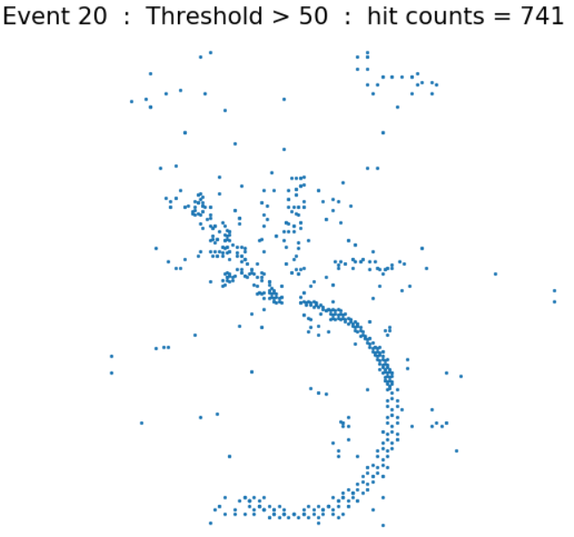
pytpc peak charge values
Manual peak charge values

Slide 6
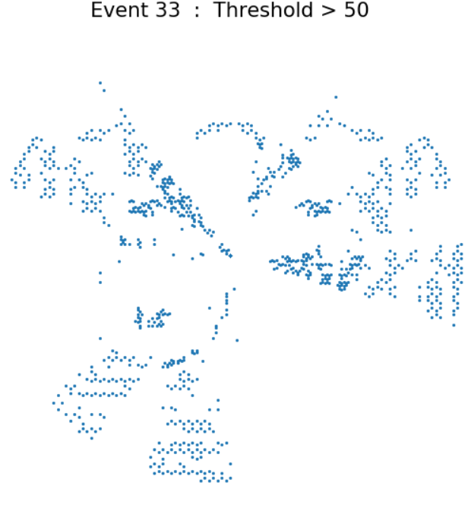
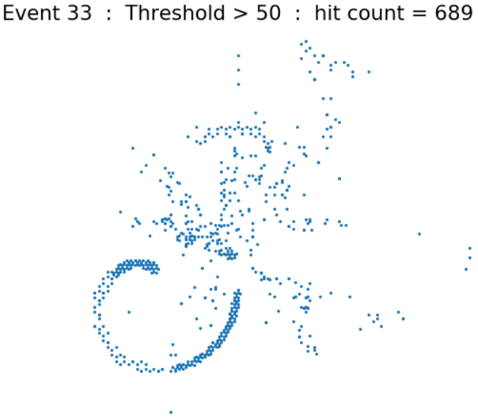
pytpc peak charge values
Manual peak charge values

Slide 7
3-D Plots

Slide 8
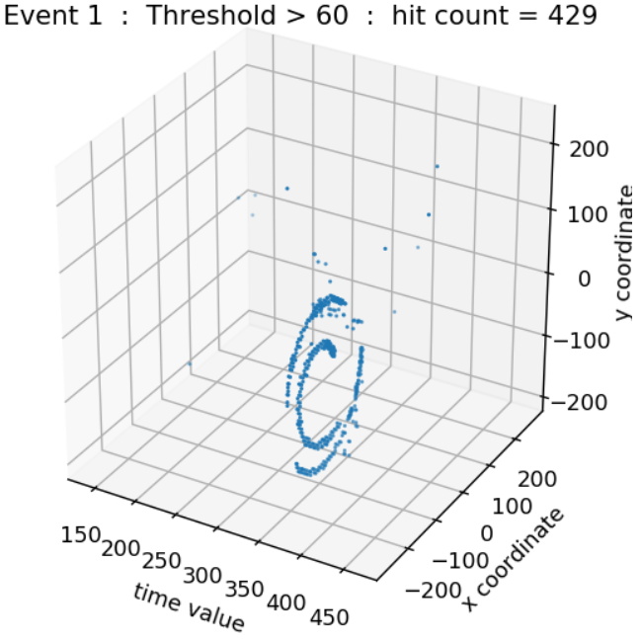

Slide 9
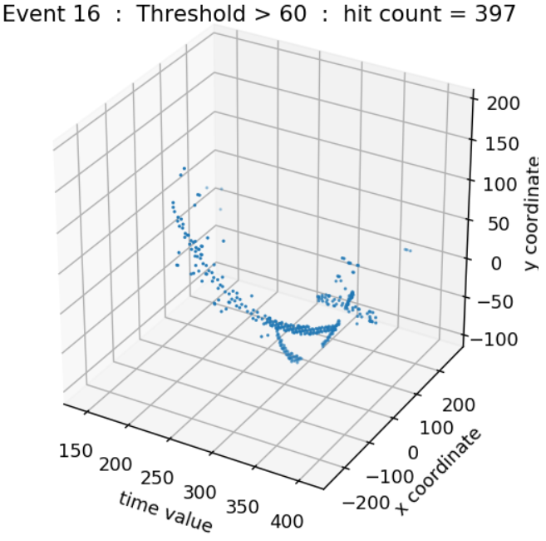
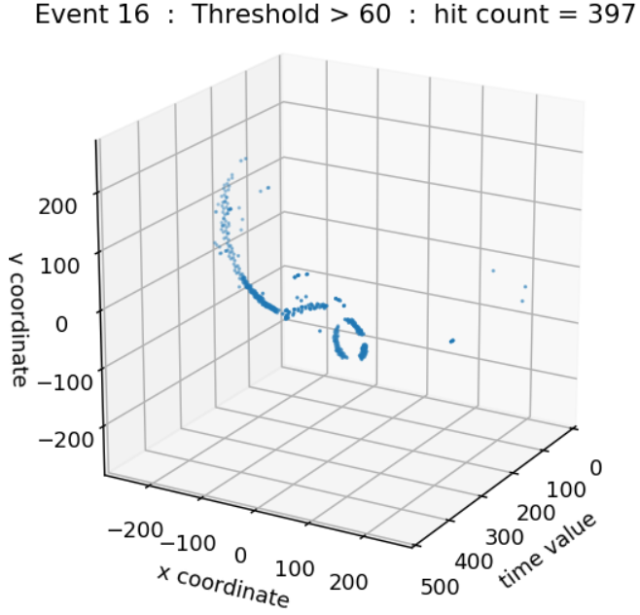
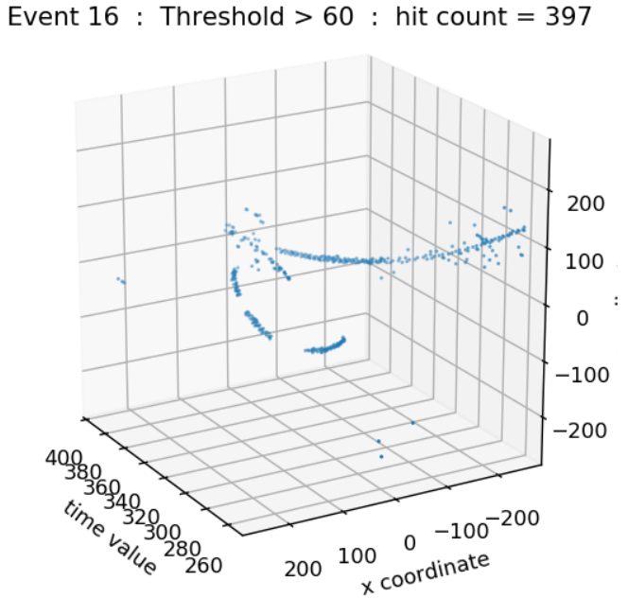

Slide 10
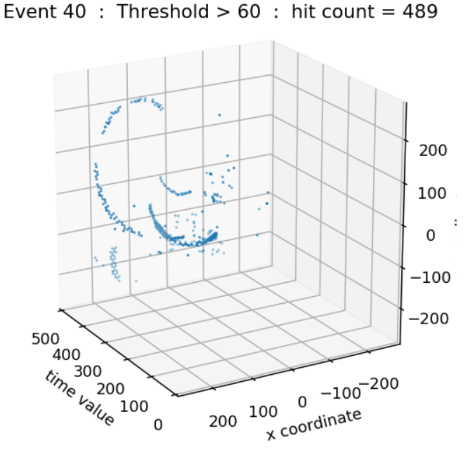

Slide 11
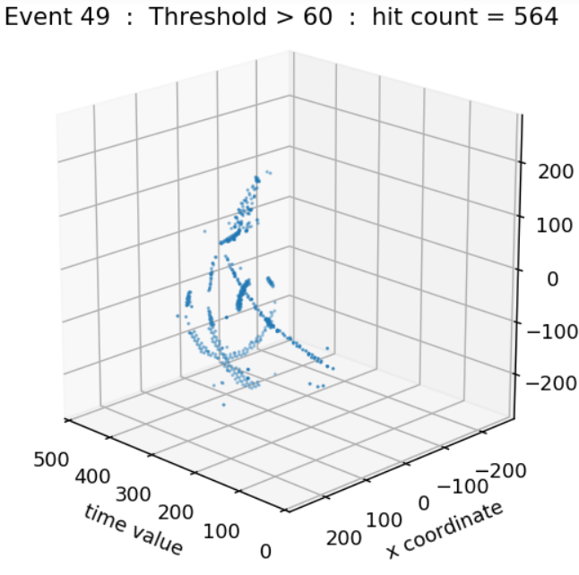

Slide 12
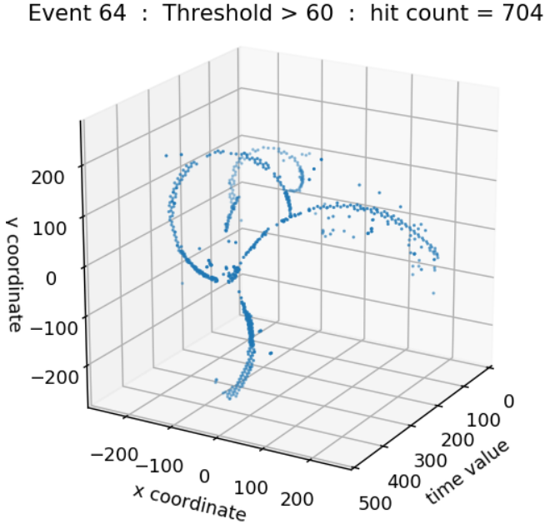

Slide 13
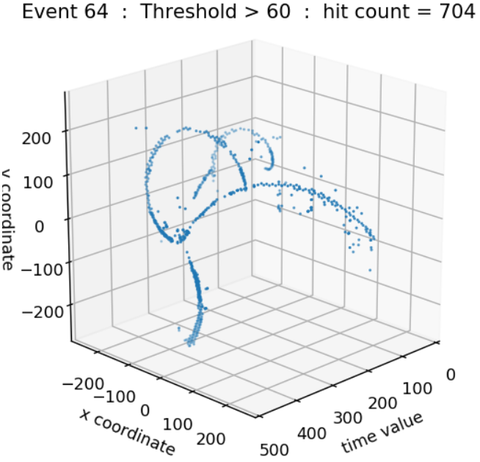

Slide 14
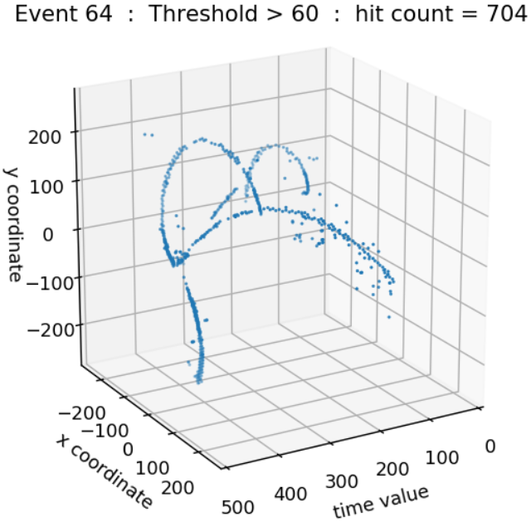

Slide 15
Next Steps
Acquire tilt information to improve plots

